Slide 1
jQuery Mobile
Lesson 03 : Working with Buttons &Toolbars
Notes:
Add instructor notes here.

Slide 2
Lesson Objectives
In this lesson, you will learn :
Using headers and footers
Creating navigation bars
Understanding how positioned toolbars work
Button basics
Working with buttons
Notes:
Add instructor notes here.

Slide 3
3.1 : Using headers and footers Toolbars
A toolbar is a bar that contains buttons, text or links that user can interact with
Standard toolbars jQuery Mobile provides are:
Header bar : normally serves as page title and typically contains a page title and upto two buttons
Footer bar : usually the last element in every mobile page. Typically contains a combination of text and buttons
Navigation Bar : Typically consists of a set of buttons that allows user to navigate through the application views
Notes:
Add instructor notes here.

Slide 4
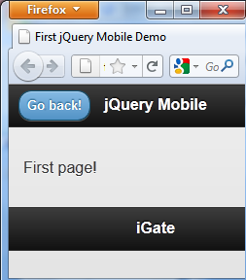
3.1 : Using headers and footers Header & Footer bar
Creating a header:
add a element with a data-role='header' attribute:
Adding the data-rel="back“ attribute will display a back button
Creating a Footer:
add a element with a data-role=‘footer' attribute:
<div data-role="header">
<h1> jQuery Mobile </h1>
</div>
<div data-role="header">
<a href="index.html" data-rel="back">Go back!</a>
<h1> jQuery Mobile </h1>
</div>
<div data-role=“footer“> … </div>
Notes:
Header Bar : You may use any of the heading levels from H1 through H6 to represent the page title. They are treated and styled the same, provided they are inside a div whose data-role is set to 'header'.
The framework automatically provides a back button and a home button on every page. If back button is not required, use the data-backbtn="false" attribute to the header container:
<div data-role="header" data-backbtn="false">
<h1>Page title</h1>
</div>
The Footer bar tends to be more freeform than the header in terms of content and functionality, but typically contains a combination of text and buttons. Again, for the heading, any heading level (H1-H6) can be used.
Add instructor notes here.

Slide 5
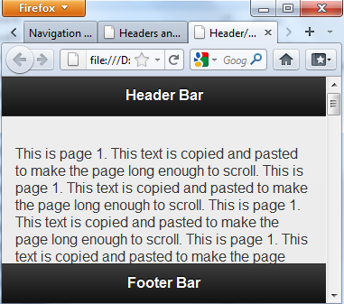
3.1 : Using headers and footers Fixed positioning
Header and/or footer toolbars can be fixed to one position by adding a data-position="fixed" attribute to the element
<div data-role="header" data-position="fixed">
<h1>Fixed header</h1>
</div>
Notes:
The previous toolbars are not fixed: they move when scrolling the window. This is the default behavior.
Fixed positioning allows page content to flow naturally. Hence, we can take advantage of native scrolling instead of scripting a workaround. The header and footer divs remain in the flow of the document, but whenever they are out of view, a screen tap makes them appear. Tapping again or scrolling the page will cause them to reappear in the flow of the page ie- when a bar scrolls out of the viewport, the bar is automatically repositioned back into view.
Tapping the screen is a toggle activity. Tapping the page when the toolbars aren't visible brings them into view; tapping again hides them until you tap again.
Add instructor notes here.

Slide 6
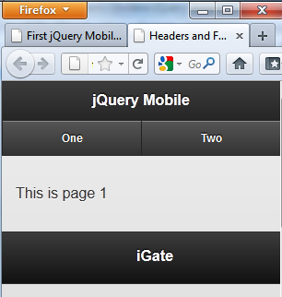
3.2 : Creating navigation bars Creating navigation bars
A navbar is an unordered list of links wrapped into a container element that has a data-role="navbar" attribute.
<div data-role="footer">
<div data-role="navbar">
<ul>
<li><a href="one.html">One</a></li>
<li><a href="two.html">Two</a></li>
</ul>
</div>
</div>
Notes:
You can place a navbar either in the header (right after the page title) or in the footer. The anchor tags contained within this element will be formatted as a button group. jQuery Mobile handles changing the active and inactive states of the buttons automatically.
If you do not put the anchors into an unordered list, the buttons will all have uneven width.
You can fit up to five items in a formatted navigation bar. If more than five elements are added, the navbar will wrap to multiple lines as seen in the below figure:
Add instructor notes here.

Slide 7
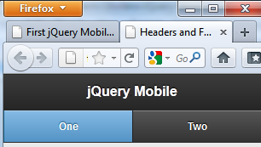
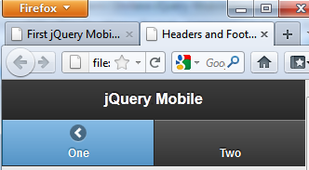
3.2 : Creating navigation bars Creating navigation bars
One link can be set to the active state by adding class ui-btn-active to it.
Icons can be added to navbar elements by specifying a data-icon attribute.
Icons are displayed on top of the text by default
<li><a href="one.html" class="ui-btn-active">One</a></li>
<li><a href="one.html" data-icon="arrow-l"
class="ui-btn-active“>One</a>
</li>
Notes:
Icons are displayed on top of the text by default.
data-icon=“arrow-u” : creates a icon that has a “up” arrow. Similarly we have data-icon=“arrow-r” and data-icon="arrow-d"
Add instructor notes here.

Slide 8
Demo
HeadersFooters.html
NavPosition.html
Navbar.html
Notes:
Code for these demos has been discussed in the earlier slides.
Pls. see the demos in lesson-3 folder.
Add instructor notes here.

Slide 9
3.3 : Working with buttons Button basics
Buttons are core widgets in jQuery Mobile, and are used within a wide range of other plugins.
The button markup is flexible and can be created from links or form buttons.
Each button has a range of styling options including icons and positioning, inline and mini sizing, grouping sets, and theming.
Use anchor links (<a> elements) to mark up navigation buttons and input or button elements for form submission.
Any anchor link can be styled as a button by adding the data-role="button" attribute
Buttons can also be created with the input tag or the button tag.
<a href=“#" data-role="button">Link Button</a>
examples
<button>Button element</button>
<input type="button" value="Button" />
Notes:
jQuery Mobile allows buttons to be created with the input tag or the button tag, the former using the type attribute value "button", "submit", "image" or "reset" to display the button. They do not require any additional options.
They are then enhanced by jQuery Mobile to make them more attractive and useable on a mobile device. Buttons of jQuery Mobile renders with centered label, rounded corners and shadows by default.
jQuery Mobile also allows buttons to be created with the <a> tags (form links) by adding the data-role="button" attribute. The jQuery Mobile framework automatically adds the necessary CSS classes to style the link as a button.
Fundamental difference between regular buttons and the “link” buttons is that regular buttons are used in forms and perform some kind of action. Link buttons, on the other hand, can be used anywhere and are meant only for navigation, just as an anchor link is.
In the case of HTML-based buttons, jQuery Mobile actually hides the original button (created with the input tag) and displays a custom button whose looks are better but behavior is same. When clicked, the event triggers another click event on the original, hidden button, which is responsible for actually submitting the form.
For navigation purposes, you should use link buttons instead of regular
buttons, which are best suited to submit form data because of the submit
action they perform when clicked.
Form buttons are "real" buttons, but are styled and behave just like link buttons. Every time we need to create a form
we also need some input fields and at least one button to let the user submit the data
they entered. This is where we use Form buttons for.

Slide 10
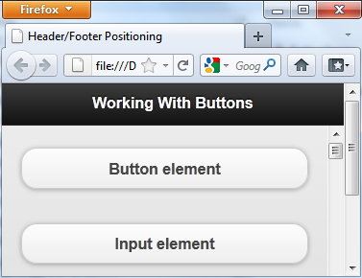
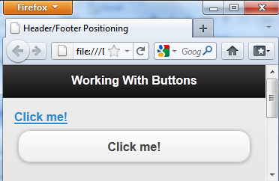
3.3 : Working with buttons Button basics
Creating form buttons
Creating link buttons
<button>Button element</button>
<input type="submit" value="Input element" />
<a href="page2.html">Click me!</a>
<a href="page2.html" data-role="button">Click me!</a>
Notes:
Form buttons are used to submit forms or interact with forms and are created using regular HTML<input> element or jQuery Mobile’s <button> element.
Links though, ideally must be used exclusively for navigation purposes.
Add instructor notes here.

Slide 11


3.3 : Working with buttons Adding icons
An icon can be added to a button by adding a data-icon attribute on the anchor specifying the icon to display.
Icon positioning : By default, all icons in buttons are placed to the left of the button text. The data-iconpos attribute allows to change the position.
A special case is when the button has only one icon and no text. This is indicated with the data-iconpos="notext" attribute
<a href="index.html" data-role="button"
data-icon="delete">Delete</a>
<a href=“a.html" data-role="button" data-icon="delete" data-iconpos="right“>
<a href=# data-role=button
data-icon=“plus” data-iconpos=“notext”></a>
Notes:
Buttons can include icons for better appearance.
The jQuery Mobile framework includes a selected set of icons most often needed for mobile apps. To minimize download size, jQuery Mobile includes a single white icon sprite, and automatically adds a semi-transparent black circle behind the icon to ensure that it has good contrast on any background color. The data-icon attribute has the following valid values.
Valid values for data-iconpos attribute are:
Left
Right
Top
Bottom
notext
jQuery Mobile’s button icon classes are all designed around icons that are 18 × 18 pixels square. If you will be using jQuery Mobile’s theming system, you should probably save your icons in PNG format with alpha transparency.

Slide 12
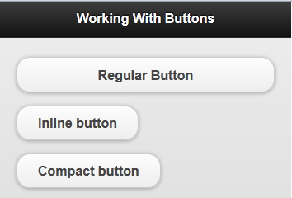
3.3 : Working with buttons Displaying buttons
Inline buttons : make buttons as wide as they need to be in order to correctly contain the button text.
Add the data-inline="true" attribute to the button
Adding the data-mini="true" to the inline buttons creates a more compact version
<a href="inline.html" data-role="button" >
Regular Button</a>
<a href="inline.html" data-role="button"
data-inline="true">Inline button</a>
<a href="inline.html" data-role="button"
data-inline="true" data-mini="true">
Compact button</a>
Notes:
Inline buttons : By default, all buttons in the body content are styled as block-level element so they fill the width of the screen. If you want a more compact button that is only as wide as the text and icons inside, add the data-inline="true" attribute to the button.
jQuery Mobile’s button icon classes are all designed around icons that are 18 × 18 pixels square. If you will be using jQuery Mobile’s theming system, you should probably save your icons in PNG format with alpha transparency.

Slide 13
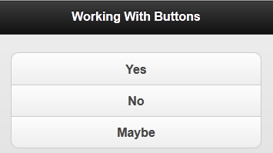

3.3 : Working with buttons Grouping buttons
You may want to visually group a set of buttons together to form a single block that looks contained like a navigation component.
Wrap a set of buttons in a container with the data-role= "controlgroup" attribute
Adding a data-type="horizontal" attribute to the control group element shows a horizontal group of buttons.
<div data-role="controlgroup">
<a href=“a.html" data-role="button">Yes</a>
<a href=“a.html" data-role="button">No</a>
<a href=“a.html" data-role="button">Maybe</a>
</div>
<div data-role="controlgroup“data-type="horizontal" >
… …
</div>
Notes:
If you wrap a set of buttons in a container with the data-role="controlgroup" attribute, the framework will create a vertical button group, remove all margins and drop shadows between the buttons and only round the first and last buttons of the set to create the effect that they are grouped together.
The controlgroup will wrap to multiple lines if the number of buttons or the overall text length is too wide for the screen.
jQuery Mobile’s button icon classes are all designed around icons that are 18 × 18 pixels square. If you will be using jQuery Mobile’s theming system, you should probably save your icons in PNG format with alpha transparency.

Slide 14
Demo
Buttons.html
Notes:
Pls. see the demos in lesson-3 folder.
$("#firstpage").live('pageinit', function (evt) {
$("#btn1").button("disable");
});
If you're familiar with jQuery, you might recall that to execute your code as soon as the DOM is loaded you need to initialize inside the $(document).ready() function. With jQuery Mobile, for initialization you bind to the pageinit event, as shown in above listing and also in the Buttons.html page.
The pageinit event is triggered for the referenced page after page initialization occurs. It will work regardless of how the page is loaded (directly or with Ajax).
Add instructor notes here.

Slide 15
X.X: [Topic] Lab
Lab Topic
Notes:
Add the notes here.
Add instructor notes here.

Slide 16
Summary
In this lesson, you learnt:
Using headers and footers
Creating navigation bars
Understanding how positioned toolbars work
Button basics
Working with buttons
Notes:
Add the notes here.
Add instructor notes here.

Slide 17
Review Question
Question 1 : You wrap a set of buttons in a container with the ________attribute
Option 1 : data-role= "controlgroup"
Option 2 : data-role= “Buttongroup"
Option 3 : data-role= “GroupButtons"
Question 2 : By default, header and footer toolbars are fixed.
True/False
Question 3: To create a compact button that is only as wide as the text and icons inside, we need to add ______ attribute to the button
Option 1 : data-compact="true"
Option 2 : data-mini="true"
Option 3 : data-inline="true"
Notes:
Add the notes here.
Add instructor notes here.
Answer 1 : option 1
Answer 2 : false
Answer 3 : option 3

